Slide 1
CPU Performance
Textbook – Chapter 1
Lecture 28

Slide 2
Measures of Performance Response Time or Execution Time
The time between the start and completion of a task.
The total time required for the computer to complete a task, including disk accesses, memory accesses, I/O activities, operating system overhead, CPU execution time, and so on.
A Personal Computer User is interested in reducing the Response Time.

Slide 3

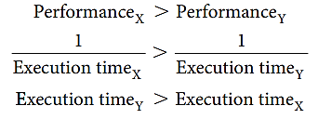
Performance
To maximize performance, we want to minimize response time or execution time for some task.
This means that for two computers X and Y, if the performance of X is greater than the performance of Y, we have:
That is, the execution time on Y is longer than that on X, if X is faster than Y.

Slide 4


Relative Performance
“X is n times faster than Y”—or equivalently “X is n times as fast as Y”— means
If X is n times as fast as Y, then the execution time on Y is n times as long as it is on X:

Slide 5


CPU Execution Time for a Program
Clock Cycle Time = 1 / Clock Rate
Notes:
Th is formula makes it clear that the hardware designer can improve performance by reducing the number of clock cycles required for a program or the length of the clock cycle. As we will see in later chapters, the designer oft en faces a trade-off between the number of clock cycles needed for a program and the length of each cycle. Many techniques that decrease the number of clock cycles may also increase the clock cycle time.

Slide 6
Instruction Performance
Since different instructions may take different amounts of time depending on what they do, CPI is an average of all the instructions executed in the program.

Slide 7
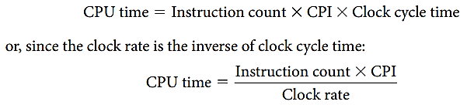
The Classic CPU Performance Equation
Instruction count: The number of instructions executed by the program.
CPI: Average Clock Cycles per Instruction

Slide 8
Relative Performance Example-1
If computer A runs a program in 10 seconds and computer B runs the same program in 15 seconds, how much faster is A than B?

Slide 9
Relative Performance Example-1
If computer A runs a program in 10 seconds and computer B runs the same program in 15 seconds, how much faster is A than B?

Slide 10
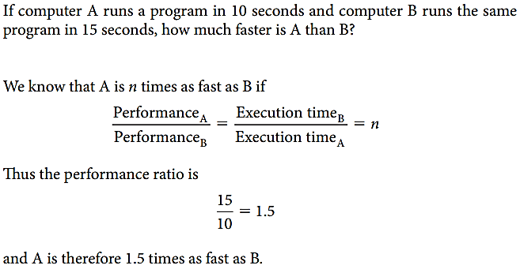
Relative Performance Example-1

Slide 11
Improving Performance Example-2
Our favorite program runs in 10 seconds on computer A, which has a 2 GHz clock. We are trying to help a computer designer build a computer, B, which will run this program in 6 seconds. The designer has determined that a substantial increase in the clock rate is possible, but this increase will affect the rest of the CPU design, causing computer B to require 1.2 times as many clock cycles as computer A for this program. What clock rate should we tell the designer to target?
Notes:
Page 34

Slide 12
Improving Performance Example-2 (Contd.)
Our favorite program runs in 10 seconds on computer A, which has a 2 GHz clock. We are trying to help a computer designer build a computer, B, which will run this program in 6 seconds. The designer has determined that a substantial increase in the clock rate is possible, but this increase will affect the rest of the CPU design, causing computer B to require 1.2 times as many clock cycles as computer A for this program. What clock rate should we tell the designer to target?
Notes:
Page 34

Slide 13
CPU Execution Time for a Program
Clock Cycle Time = 1 / Clock Rate
Notes:
Th is formula makes it clear that the hardware designer can improve performance by reducing the number of clock cycles required for a program or the length of the clock cycle. As we will see in later chapters, the designer oft en faces a trade-off between the number of clock cycles needed for a program and the length of each cycle. Many techniques that decrease the number of clock cycles may also increase the clock cycle time.

Slide 14
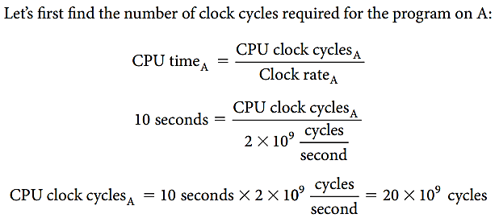
Improving Performance Example-2 (Contd.)
Notes:
Page 34

Slide 15
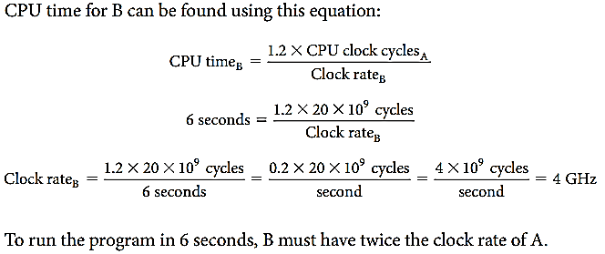
Improving Performance Example-2 (Contd.)
Notes:
Page 34

Slide 16
Using the Performance Equation Example-3
Suppose we have two implementations of the same instruction set architecture. Computer A has a clock cycle time of 250 ps and a CPI of 2.0 for some program, and computer B has a clock cycle time of 500 ps and a CPI of 1.2 for the same program. Which computer is faster for this program and by how much?

Slide 17
Using the Performance Equation Example-3 (Contd.)
Suppose we have two implementations of the same instruction set architecture. Computer A has a clock cycle time of 250 ps and a CPI of 2.0 for some program, and computer B has a clock cycle time of 500 ps and a CPI of 1.2 for the same program. Which computer is faster for this program and by how much?

Slide 18
CPU Execution Time for a Program
Notes:
Th is formula makes it clear that the hardware designer can improve performance by reducing the number of clock cycles required for a program or the length of the clock cycle. As we will see in later chapters, the designer oft en faces a trade-off between the number of clock cycles needed for a program and the length of each cycle. Many techniques that decrease the number of clock cycles may also increase the clock cycle time.

Slide 19
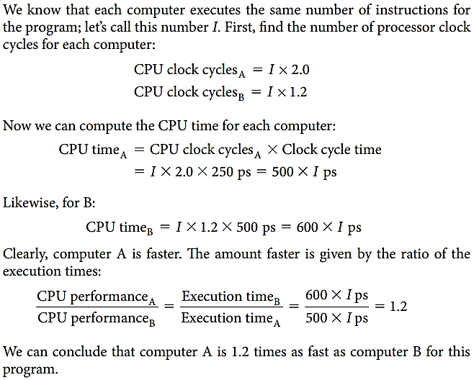
Using the Performance Equation Example-3 (Contd.)

Slide 20
The Classic CPU Performance Equation
Instruction count: The number of instructions executed by the program.

Slide 21
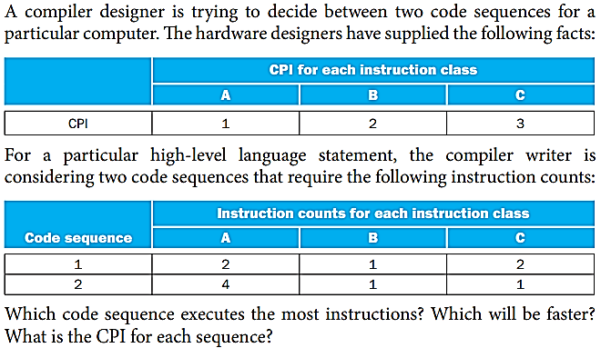
Comparing Code Segments Example-4

Slide 22
Comparing Code Segments Example-4 (Contd.)

Slide 23
Comparing Code Segments Example-4 (Contd.)
i) Which code sequence executes the most instructions?
Answer:
Sequence 1 executes 2 + 1 + 2 = 5 instructions.
Sequence 2 executes 4 + 1 + 1 = 6 instructions.
Therefore, sequence 1 executes fewer instructions.

Slide 24
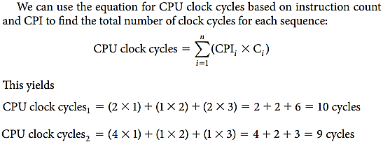
Comparing Code Segments Example-4 (Contd.)
ii) Which will be faster?
So code sequence 2 is faster, even though it executes one extra instruction.

Slide 25
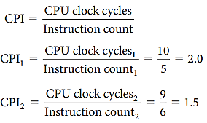
Comparing Code Segments Example-4 (Contd.)
iii) What is the CPI for each sequence?
Since code sequence 2 takes fewer overall clock cycles but has more instructions, it must have a lower CPI. The CPI values can be computed by

Slide 26
Program Execution Time

Slide 27
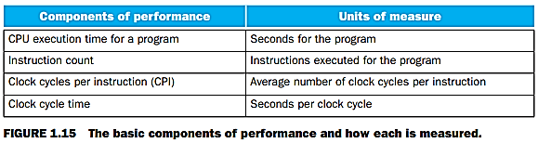
Units of Measurement

Slide 28
Reference
David A. Patterson, John L. Hennessy, Computer Organization and Design: The hardware/software interface – Chapter 1 (1.6 - Performance)

